Slide 1
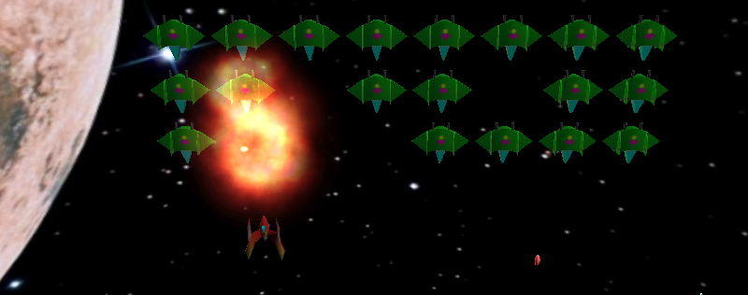
BIG BALD GAMES

